Slide 1
Open House Project - Visitor
By: Joshua Lim
Riydho

Slide 2
Table of contents
01
02
03
Week 1-6 Recap
Changes Made
Learning Outcome

Slide 3
01
Project Recap
What was done?

Slide 4
Cleaning Initial Project
Removed unnecessary packages

Slide 5
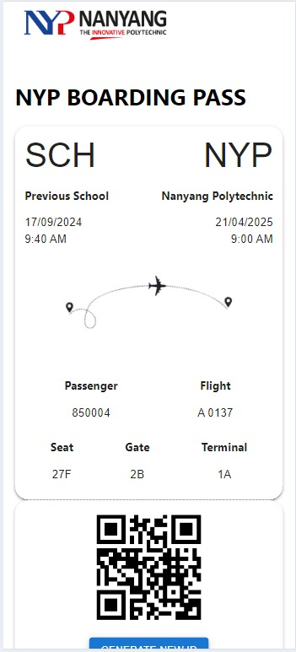
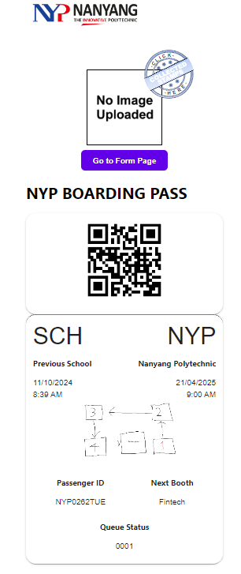
Initial Design of Landing Page
Created how the design for landing page will be
Initial
Current

Slide 6
User ID Generation
Calls and decrypts API in order to generate a unique user ID (e.g: NYP0000MON) which is currently stored in localstorage.

Slide 7
Websocket Connection (WIP)
Used AWS websocket to establish 1 to 1 communication between 2 connections to send messages
Currently able to call function via sending a specific message (cycleBooth)
Will be used in the future to update info (Booth status, queue number, profile image) so user does not need to refresh the website

Slide 8
View Collected Stamps
Created modal to display stamps (booths completed)
Stamps will be unhidden once the user completes a booth

Slide 9
FormSG Connection
Pass user ID into FormSG

Slide 10
Cartoonify Profile Picture
Able to retrieve uploaded image from FormSG and run the cartoonify filter
Cartoonified image is uploaded to S3 and can be seen on landing page

Slide 11
Feedback

Slide 12
Feedback
Change the UI to be more concise, keep within one page or scroll
Remove and clean up unnecessary items

Slide 13
02
Completed Features
Week 6-12

Slide 14
Expanded Websocket Functions
Handles messages for:
“UPDATE_STAMP”
“UPDATE_WORKSHOP”
“UPDATE_PHOTO”
“REMOVE_PHOTO”
“UPDATE_QUEUES”
“UPDATE_REDEMPTION_STATUS”
“Internal Server Error”
Edited the Lambda/AWS side codes to handle:
“Direct”
“Ping”
“Broadcast”
“Register”

Slide 15
Display from DB/API Call
Queue status
When admin has put visitor to queue, it will update the queue status
Redemption status
After booth stamps is collected, redemption status will change
Booth and workshop stamps
Admin scans QR code, booth and workshops stamps will appear

Slide 16
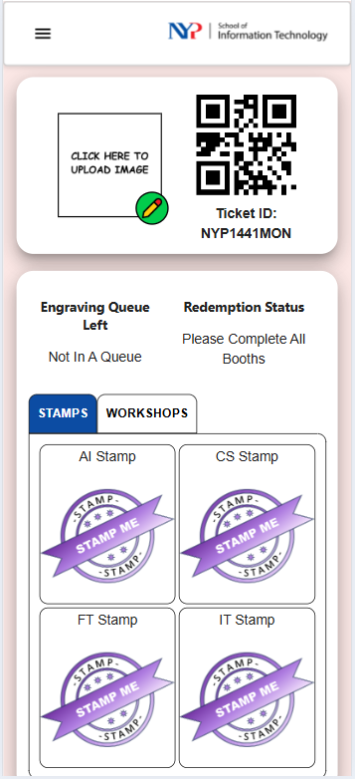
Visitor Page Redesign
Removed modal
Added profile picture and QR code in one div
Replaced boarding pass design with more user-friendly design
Easier to view stamps

Slide 17
User Role
Added Role Checker
Navigation Bar contents changed accordingly to the role
Restrict certain pages to visitor

Slide 18
Navigation/Wayfinder
Created a layout map for visitor to navigate around designated areas @ Level 2, 3, 5
Ensuring its able to zoom in and out
Labelling the path to provide navigation

Slide 19
OHMontage Interaction
When picture is uploaded, a jiggle button will appear
Colorful animation of the profile photo
Calls the API to the OHMontage

Slide 20
03
Learning Outcome
The real adventure are the friends we made along the way

Slide 21
Time Management
Always made sure we had a task to do everyday
Liaise with supervisor after each task was completed
These 2 steps ensured that there was progress every week

Slide 22
Challenges Faced
Learning ReactJS
Learning how to use AWS tools (Websocket)
Learning how to integrate APIs
Debugging (e.g: profile picture lag)

Slide 23
Tools Used:
ReactJS (Design)
NodeJS (AWS and FormSG connection)
AzureDevops
CutoutPro
Integrate Swagger API
AWS applications:
Lambda, S3, DynamoDB (AWS Websocket)
Cloudwatch, S3 (Profile Picture)
Cloudfront (AWS Deployment)

